Slide 1

Pocsai Borbála, Libor Roland

Slide 2
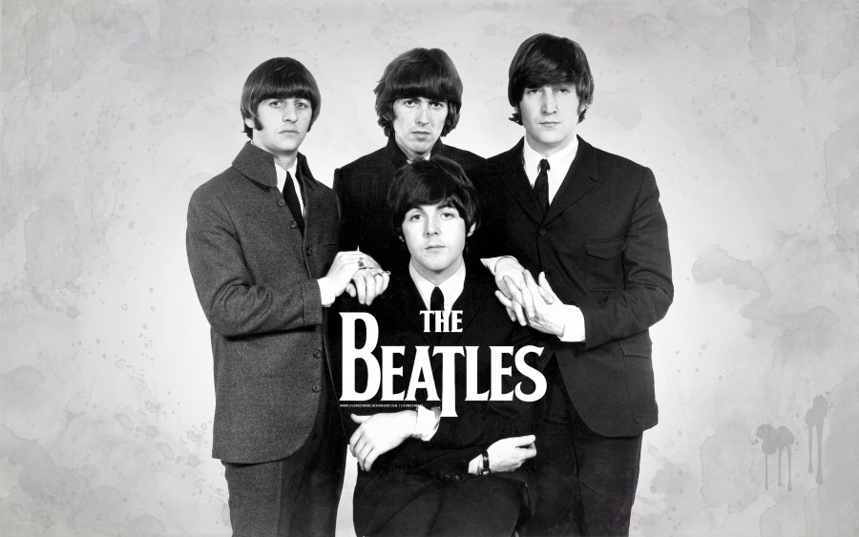
Rock and roll is a genre of popular music that originated and evolved in the United States during the late 1940s and early 1950s from musical styles such as gospel, jump blues, jazz, boogie woogie, and rhythm and blues, along with country music. The genre did not acquire its name until 1954.

Slide 3
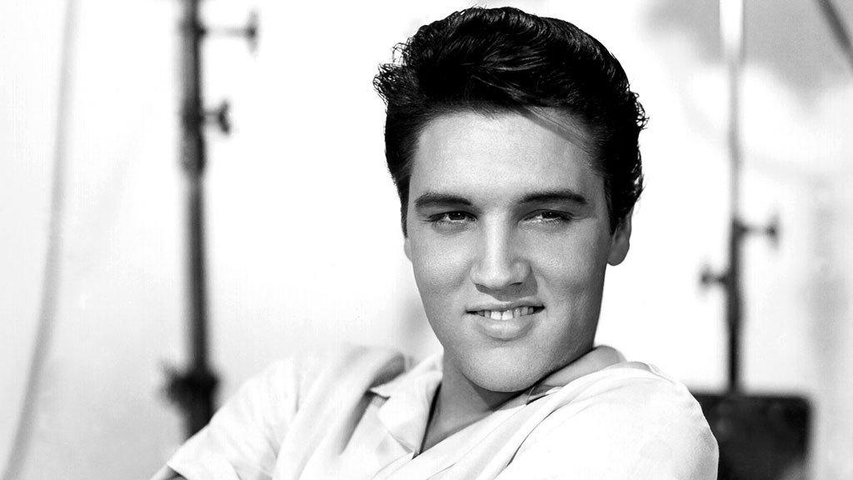
In the earliest rock and roll styles, either the piano or saxophone was typically the lead instrument, but these instruments were generally replaced or supplemented by guitar in the middle to late 1950s. The beat is essentially a dance rhythm with an accentuated backbeat, which is almost always provided by a snare drum. Classic rock and roll is usually played with one or two electric guitars (one lead, one rhythm), a double bass or string bass or (after the mid-1950s) an electric bass guitar, and a drum kit.

Slide 4
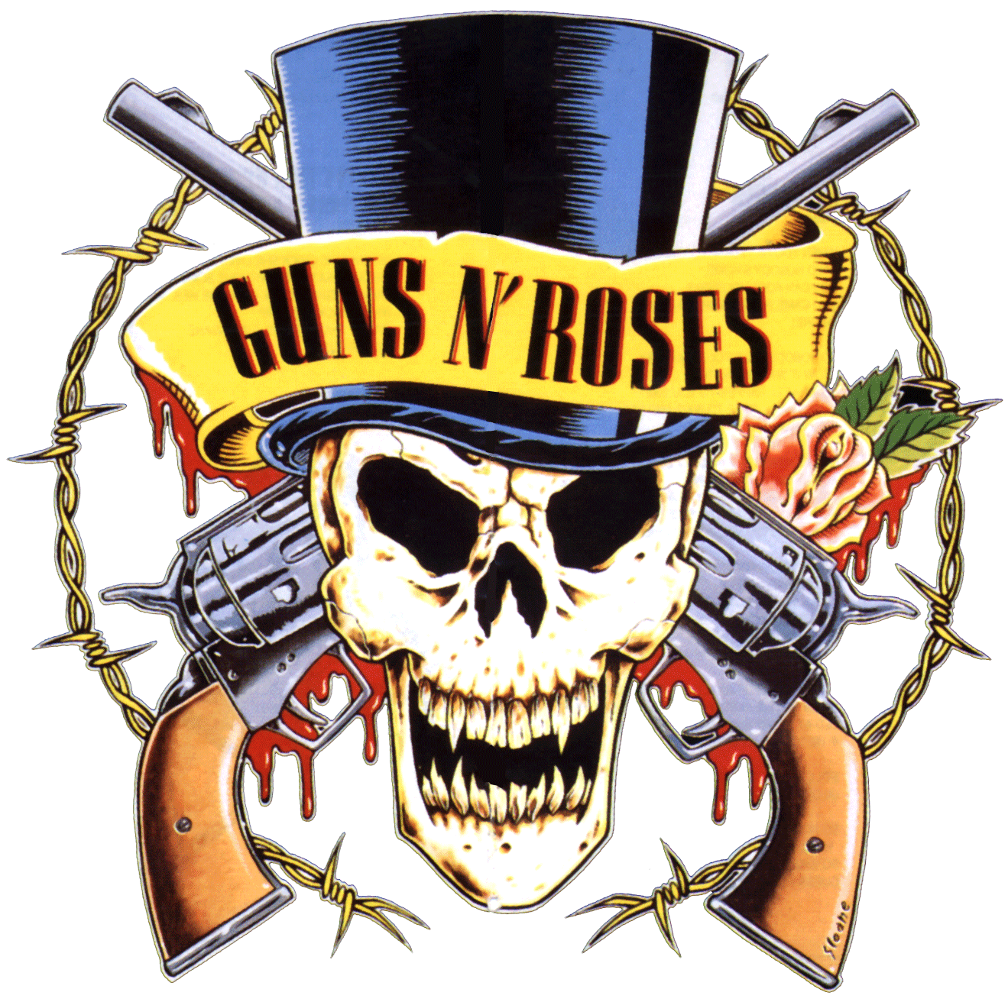
Beyond simply a musical style, rock and roll, as seen in movies, in fan magazines and on television, influenced lifestyles, fashion, attitudes, and language.

Slide 5
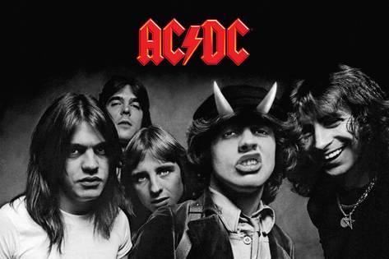
This new music tried to break boundaries and express emotions that people were actually feeling but had not talked about. From the mid-1960s as "rock and roll" was rebranded as "rock"

Slide 6
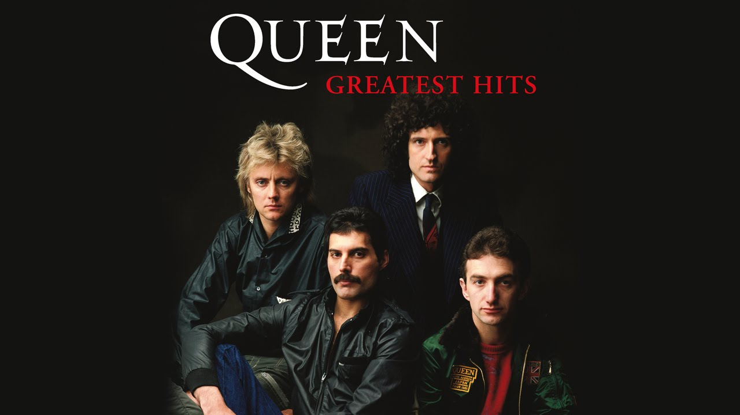
musical genres created by rock and roll:
Funk
Disco
House
Techno
Hip hop
Metal

Slide 7

Famous rock bands:
The Beatles
The Rolling Stones
AC/DC
Queen
Pink Floyd
Van Halen
Led Zeppelin
Guns N’ Roses
Aerosmith
Nirvana
Bon Jovi

