Slide 1
Zsigmond Móricz Reformed College, Secondary school, Primary School and Nursery School
Made by: Bianka Boros, Valentina Ladányi, Zsuzsa Losonczi, Rita Horog

Slide 2
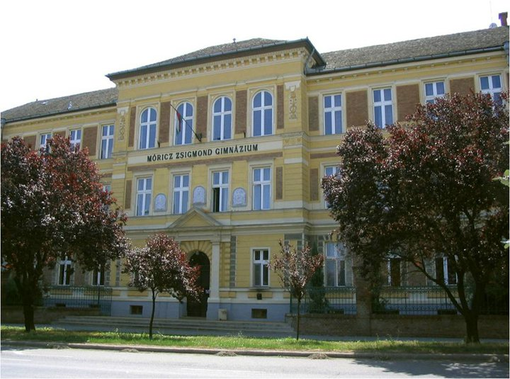

Slide 3
The freshmen’s camp
Freshmen’s Camp is for would-be ninths graders.
Students stay at the dormitory.
Funny and playful tasks.
Freshmen’s week in September.
Every day new tasks. Examples:
They have to go to school in their pyjamas
They have to wear the same colour T-shirts
They have to wear Superhero clothes.
Classes get scores for the tasks
The class which collects the most points wins the competition.
The freshmen’s ball.
Competitions
Class dances
Disco.

Slide 4
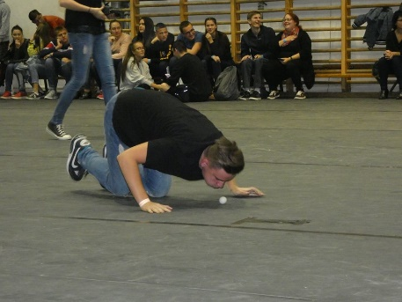
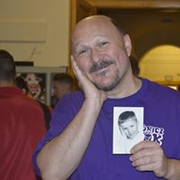
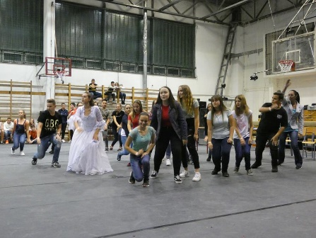
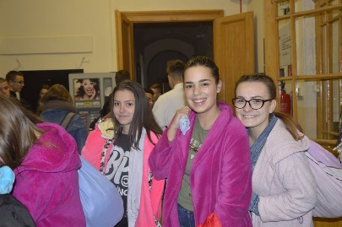
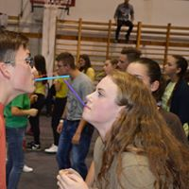
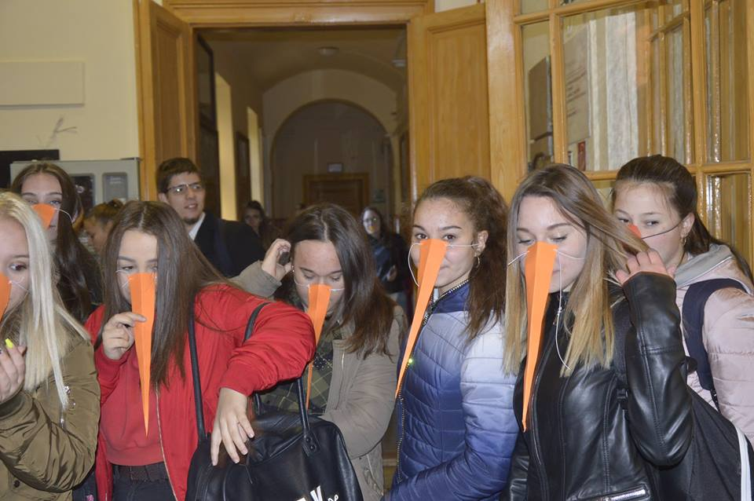
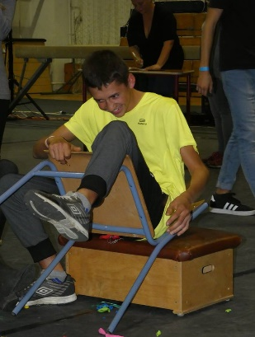
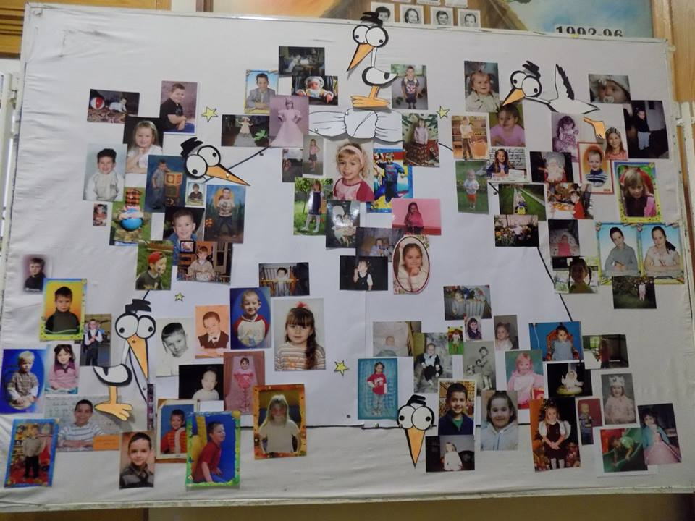
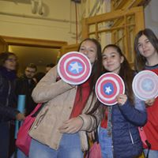
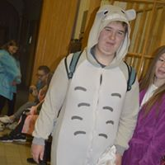
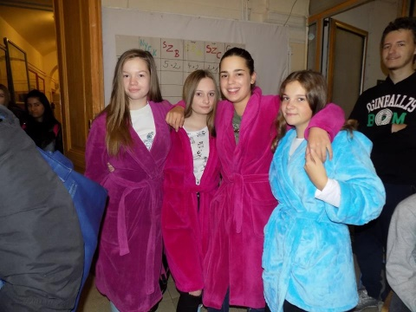
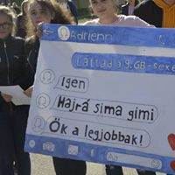
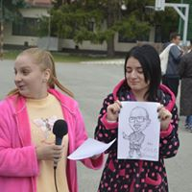
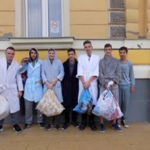
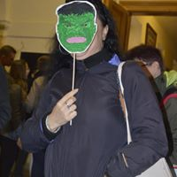
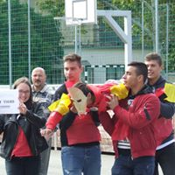
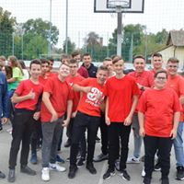
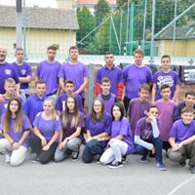
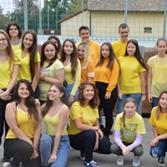
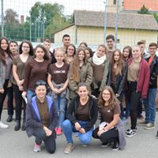
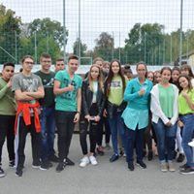

Slide 5
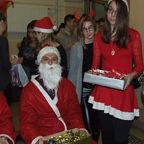
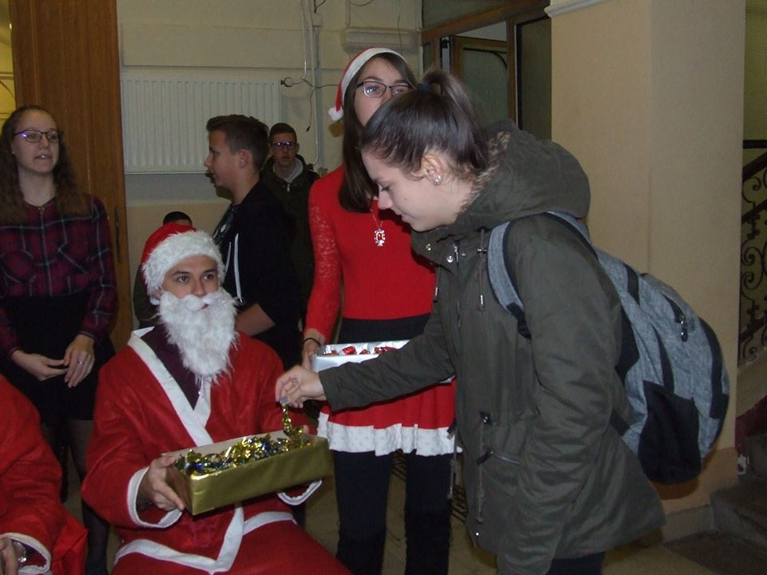
Student Government
Members of the Student government
Weekly meetings
Events
Santa day
Angel post
Student Government’s Day
Freshmen’s Camp
Freshmen’s Week
We help to the teachers during the open day and the open week
Friendly and cheerful group
Hard work but great time together

Slide 6
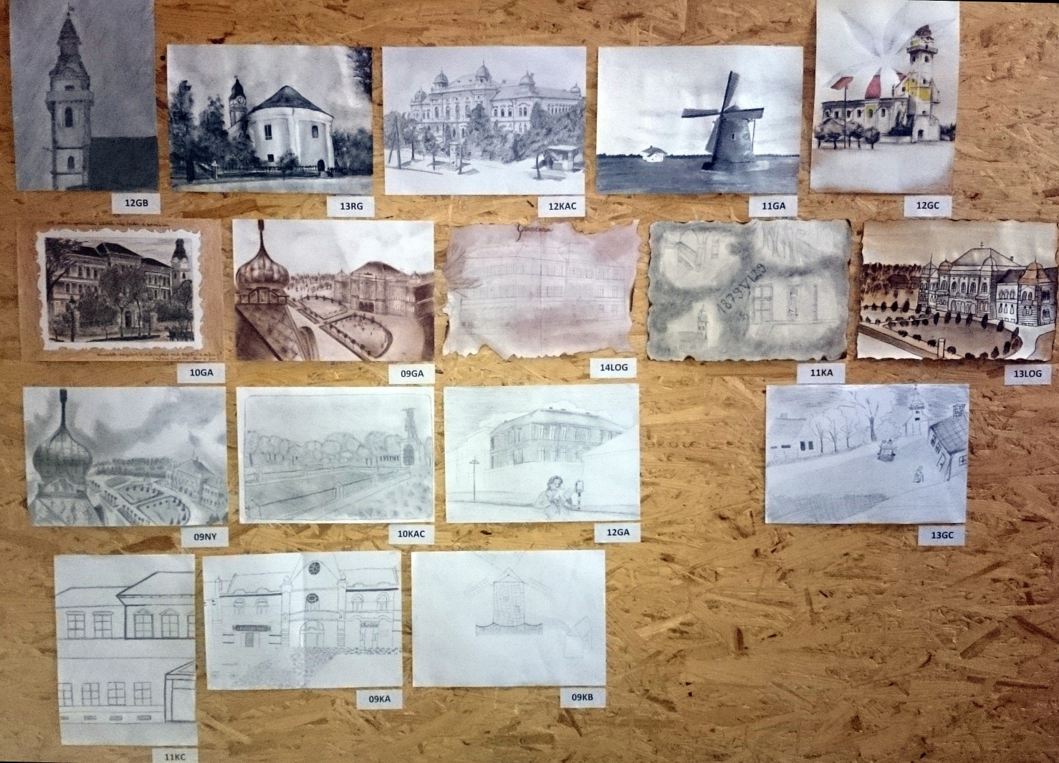
Móricz Week
Competition between classes
Cultural tasks. For example:
about the school
about the town
Facts about Zsigmond Móricz, the writer.
Draw or paint a picture about the writer or his life.
And the prizes?

Slide 7
The „face” of Móricz
Competition to choose the „face” of Móricz.
Teachers and students decided who the best is.

Slide 8
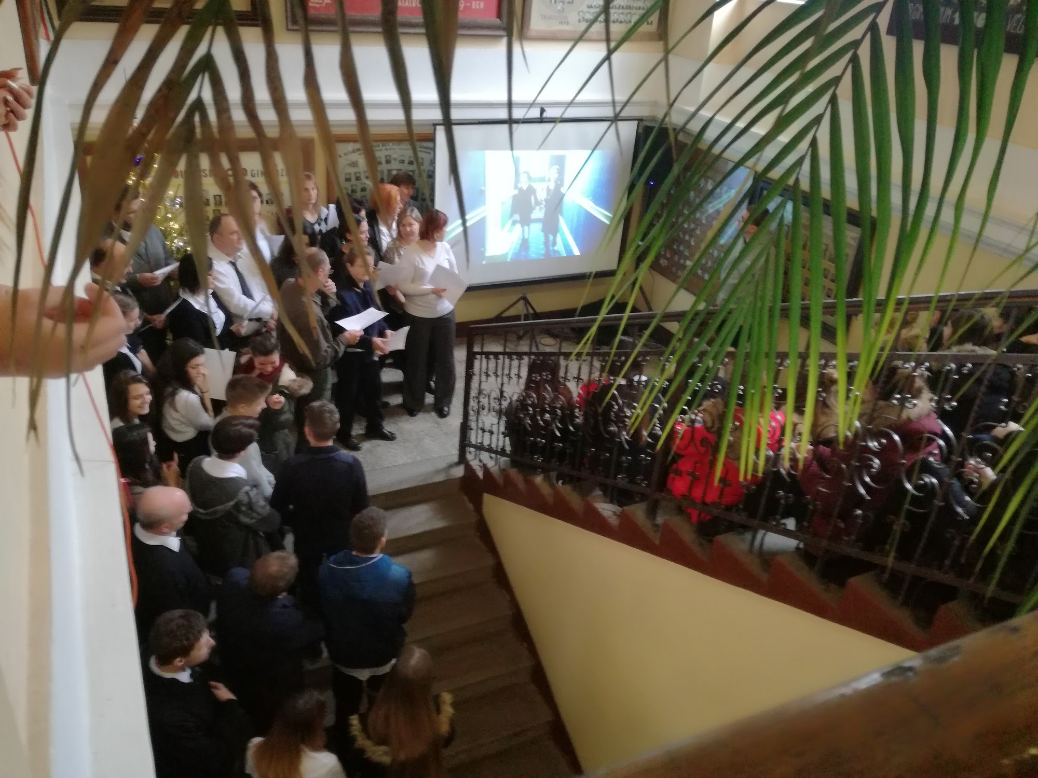
A little Christmas in the long break
The week before Christmas
10-15 minutes concert.
On the last day students and teachers sing some Christmas songs together.

Slide 9
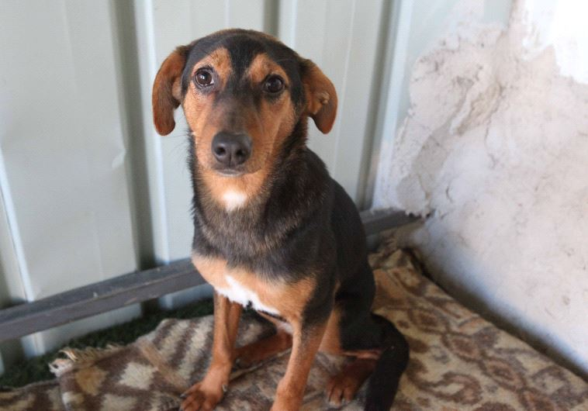
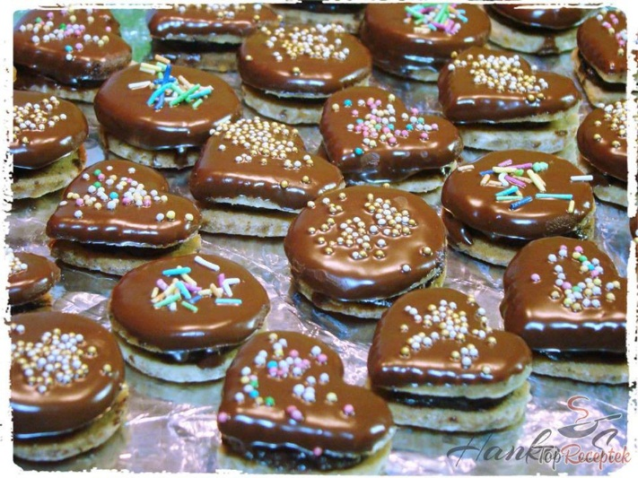
Angel post
The members of the student goverment make some biscuits and sell them to the students in the breaks.
The money is given to the local dog shelter.

Slide 10
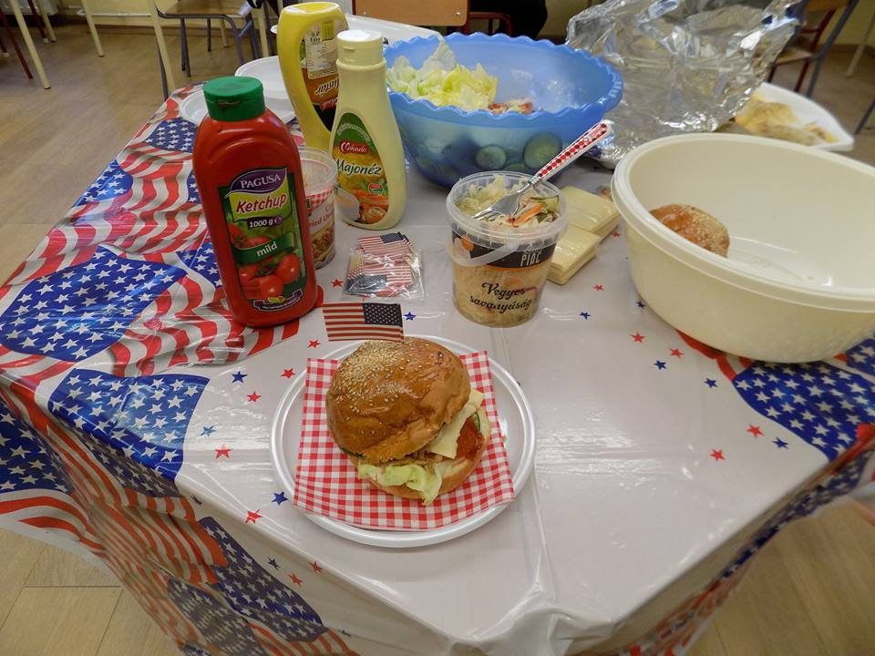
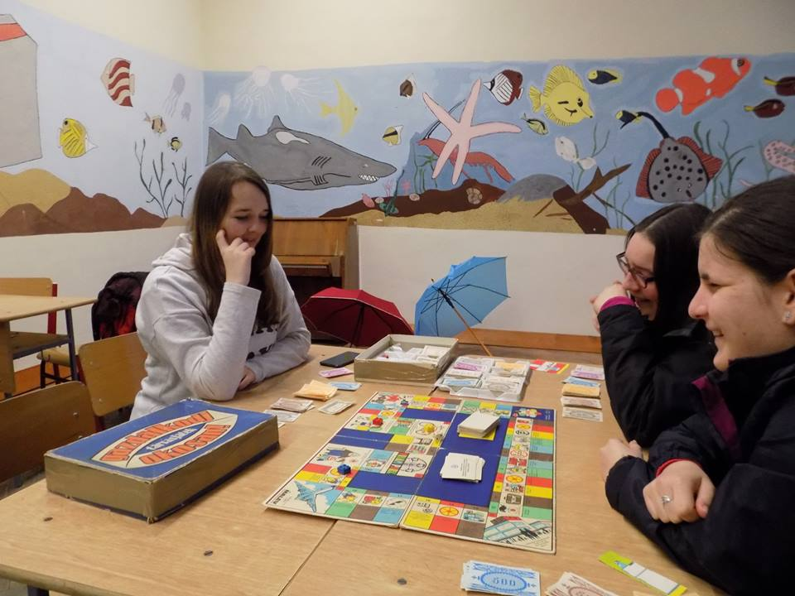
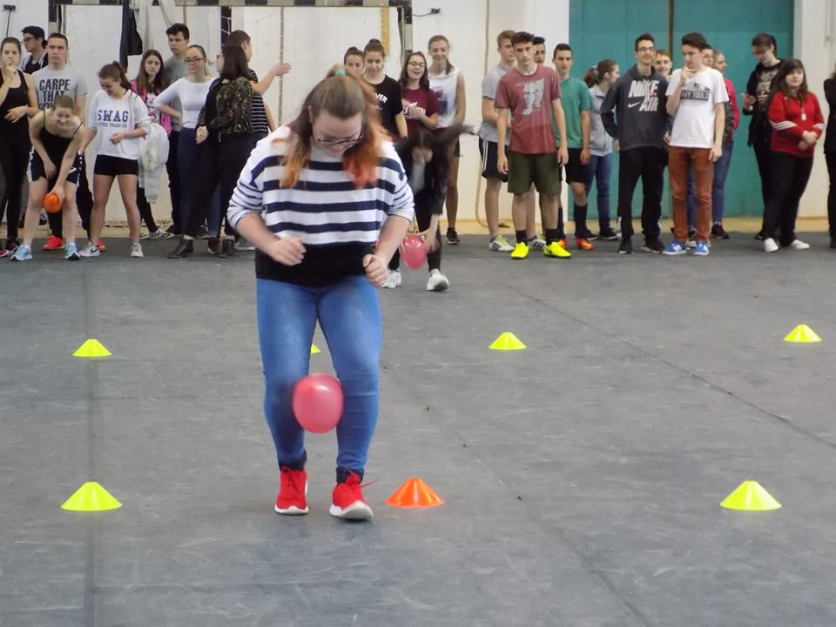
Student Government’s Day

Slide 11
Thank you for your attention!

