Slide 1
Spaceships
Created by.: Tóth Viktória, Barabás Viktória, Szabó Flóra, Hegedűs Róbert, Katona Márk Csaba

Slide 2
About the spaceships
We have always been fascinated with interstellar travel at light speeds. This fascination has spawned a host of engineering fantasy marvels called star ships reflecting the increasing desire to explore the unknown.

Slide 3
Famous spaceships
1. Millennium Falcon
Captained by smuggler Han Solo, the Millennium Falcon was a highly modified light star ship popular because of its hamburger-inspired design. In the movie Star Wars, the sound it produced as it traveled through hyper space came from two tracks of the engine noise of its McDonnell Douglas DC-9. This star ship had concealed scanner-proof smuggling compartments as well as military-class weaponry.

Slide 4
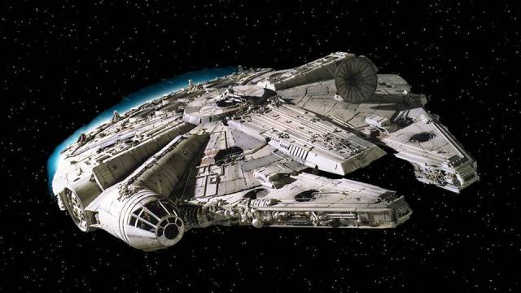
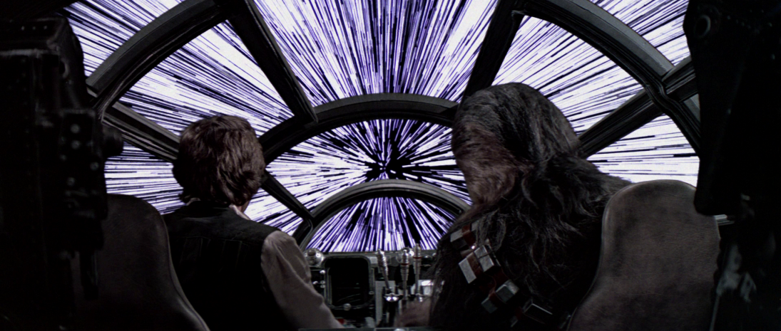
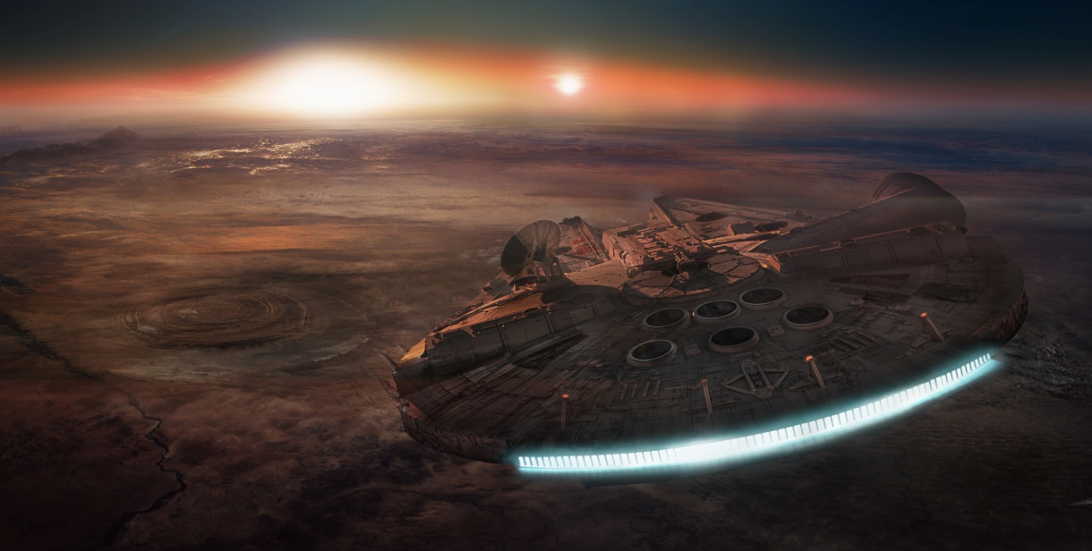

Slide 5
2. Andromeda Ascendant
The Andromeda Ascendant came into being in the Newport News Orbital Shipyards in 9768. It was the tenth star ship under the Glorious Heritage class and was captained by Dylan Hunt. This space craft had an artificial intelligence and appeared as avatar Rommie, a three-dimensional holographic projection and as a two-dimensional monitor.

Slide 6
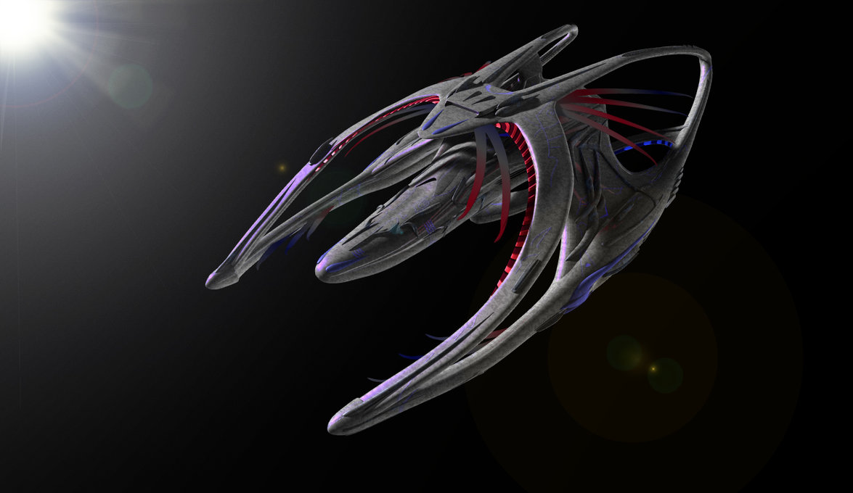
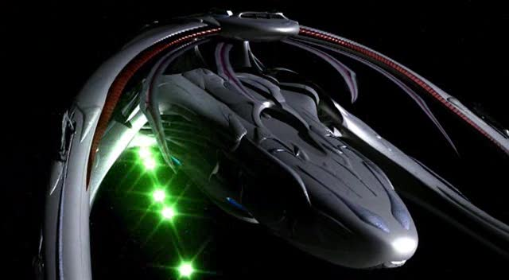
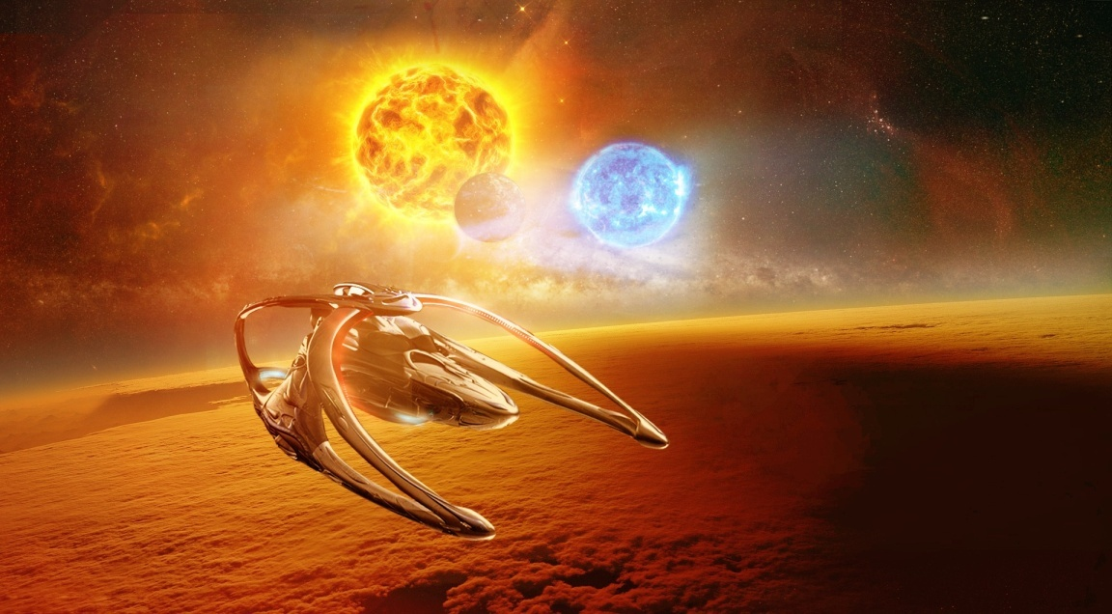

Slide 7
3. USS Enterprise
The USS Enterprise served the Starfleet in the mid-24th century and was the fifth star ship under the Federation that bore the name Enterprise. It served as the Federation flagship and was built at Utopia Planitia Fleet Yards, which orbited planet Mars in the Sol System. This spaceship can be found in the Star Trek.

Slide 8
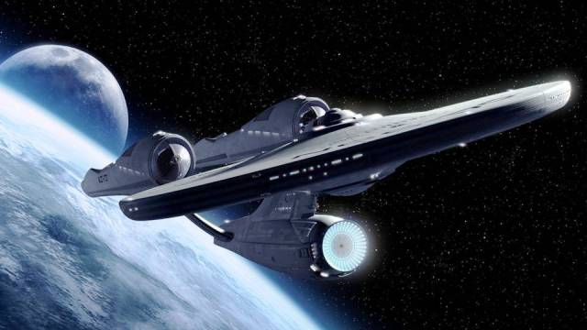
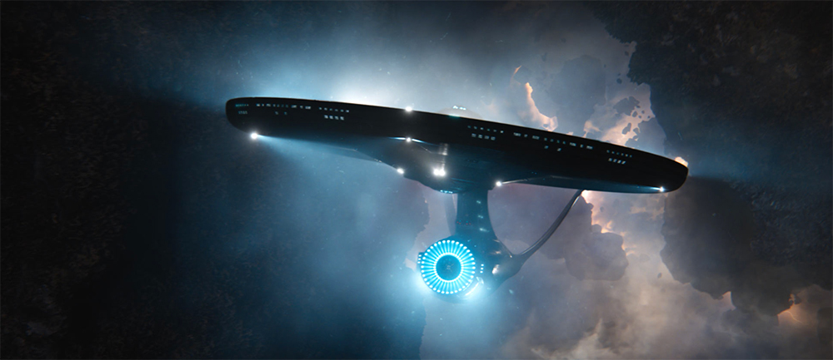
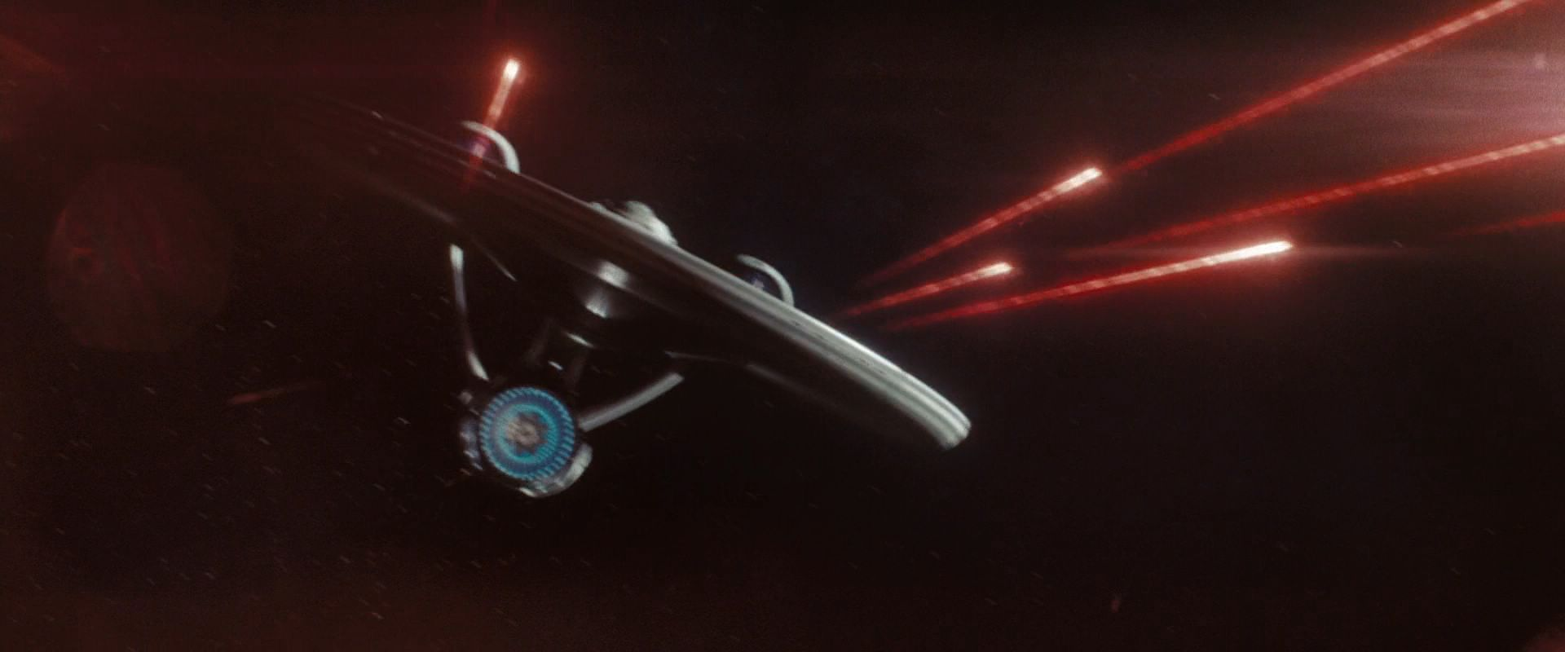

Slide 9
4. District 9 Space ship
Not much is known about this massive piece of alien technology other than the fact that it was used as an interplanetary travel device that somehow rendezvoused to earth (and the fact that it’s very…very loud). The ship is central to the story of the acclaimed District 9 movie.

Slide 10
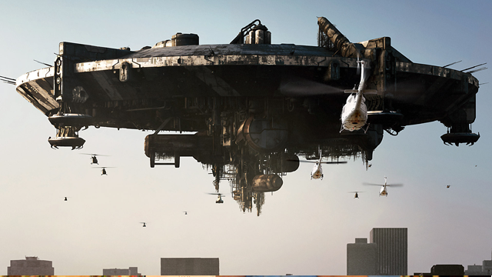
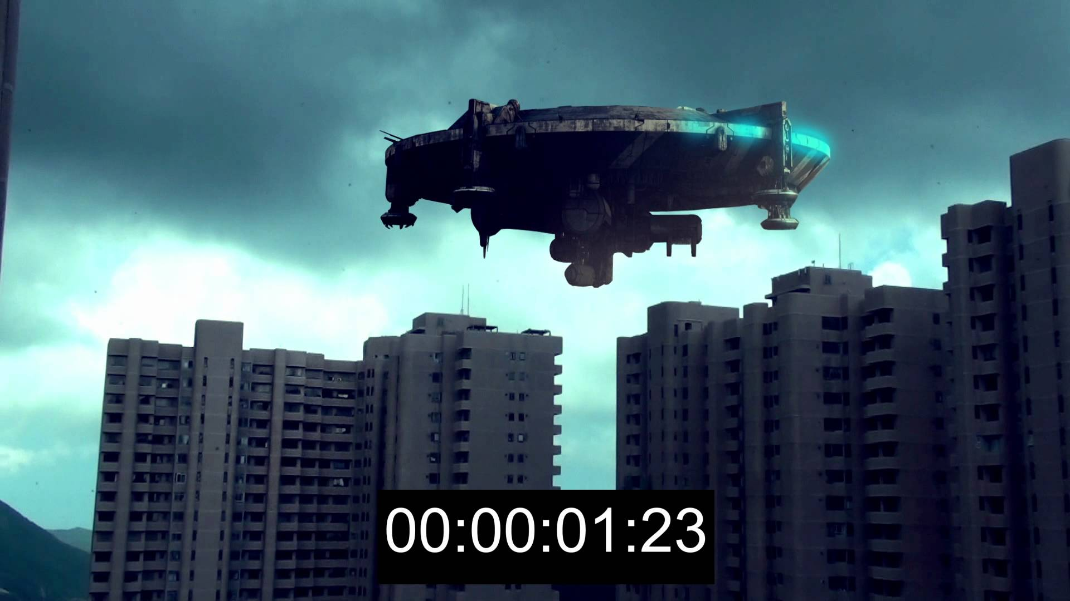
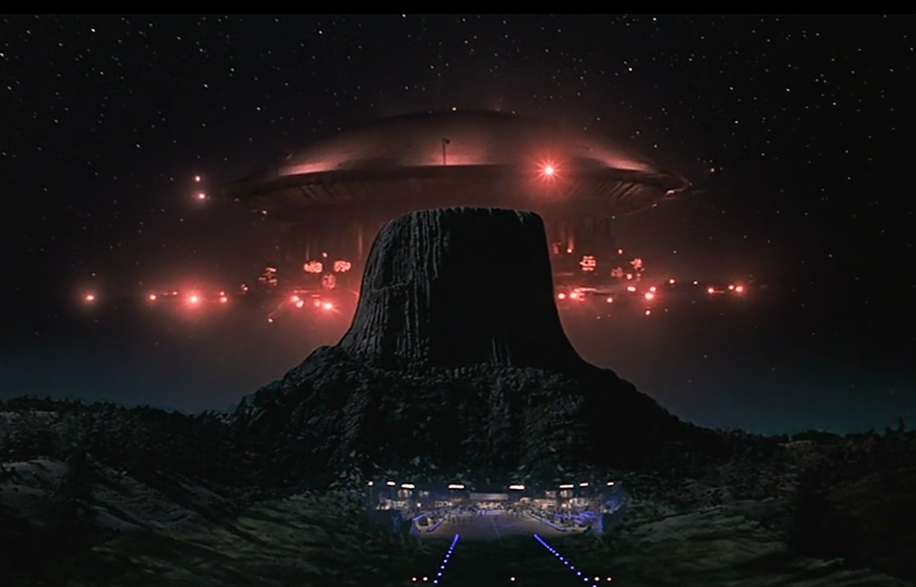

Slide 11
5. USCSS Prometheus
NX-59650 USCSS Prometheus was a Federation Prometheus star ship that served the Starfleet during the late 24th century. The ship boasted of multi-vector assault mode regenerative shields, holographic projectors on its deck and the title of the fastest ship in Starfleet.

Slide 12
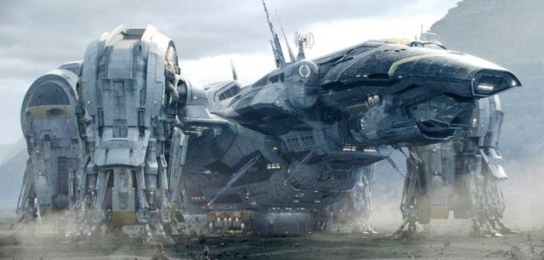
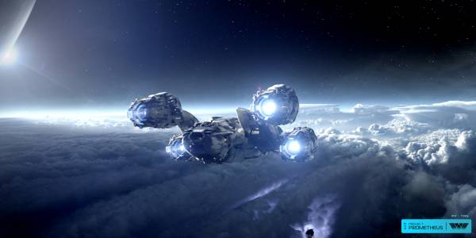
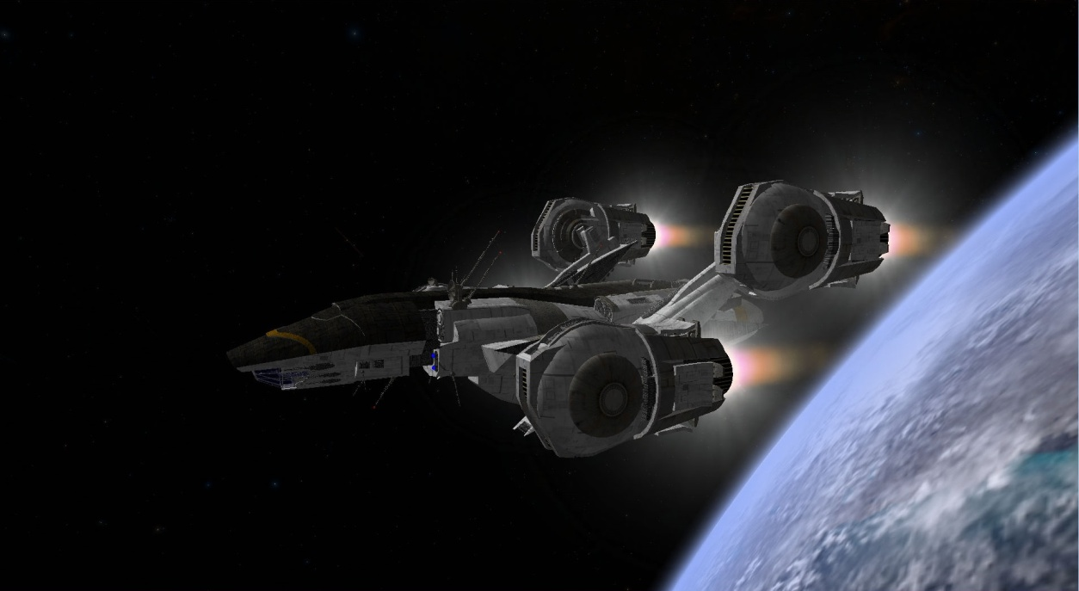

Slide 13
Thank you for your attention!

